Slide 1

CPRG 307 Slides are part of the Instructor Resources for the course required textbook and are provided with permission from the publisher:
Oracle 11g: PL/SQL Programming
Joan Casteel
978-1-133-94736-3
Course Technology (Cengage Learning)
Oracle11g:
PL/SQL Programming
Chapter 4
Cursors and
Exception Handling

Slide 2
Cursors
Work area in which SQL statement is processed
Implicit cursor – declared automatically for DML and SELECT statements
Explicit cursor – declared and managed programmatically to handle a set of rows returned by a SELECT statement
Cursor variable – reference or pointer to a work area or cursor
Oracle11g: PL/SQL Programming

Slide 3
Cursor Attributes
Attribute Name
Data
type
Description
%ROWCOUNT
Number
Number of rows affected by the SQL statement
%FOUND
Boolean
TRUE if at least one row is affected by the SQL statement, otherwise FALSE
%NOTFOUND
Boolean
TRUE if no rows are affected by the SQL statement, otherwise FALSE
Oracle11g: PL/SQL Programming

Slide 4
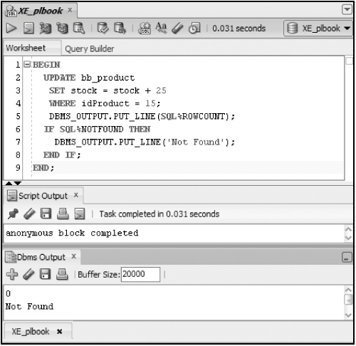
Implicit Cursor
Oracle11g: PL/SQL Programming

Slide 5
Explicit Cursor
Step
Step Activity
Activity Description
1
DECLARE
Creates a named cursor identified by a SELECT statement. The SELECT statement does not include an INTO clause. Values in the cursor are moved to PL/SQL variables with the FETCH step.
2
OPEN
Processes the query and creates the active set of rows available in the cursor.
3
FETCH
Retrieves a row from the cursor into block variables. Each consecutive FETCH issued will retrieve the next row in the cursor until all rows have been retrieved.
4
CLOSE
Clears the active set of rows and frees the memory area used for the cursor.
Oracle11g: PL/SQL Programming

Slide 6
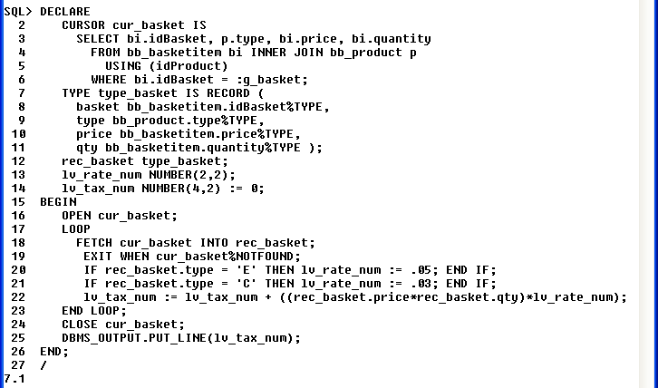
Explicit Cursor Example
Declare cursor
Declare record type
and variable
Open cursor
Fetch a row from the cursor
Check if row returned from fetch
Close cursor
Calculate tax amount
Oracle11g: PL/SQL Programming

Slide 7
Cursor FOR Loop
Handles tasks automatically for processing each row returned by a cursor (record declaration, fetch, ending loop)
Use FOR UPDATE and WHERE CURRENT OF clauses for record locking
Oracle11g: PL/SQL Programming

Slide 8
Cursor FOR Loop
If wanting to perform DML on the row being looked at in the cursor loop (DML table and cursor table are the same), must lock the rows to prevent other users from updating them while code is executing them.
Can lock the rows by adding the FOR UPDATE clause to the cursor declaration.
For UPDATE and DELETE, can then add the WHERE CURRENT OF clauses to modify the row currently be viewed in the cursor loop.
Oracle10g Developer: PL/SQL Programming

Slide 9
Cursor FOR Loop Example
DECLARE
CURSOR cur_prod IS
SELECT type, price
FROM bb_product
WHERE active = 1
FOR UPDATE NOWAIT;
lv_sale bb_product.saleprice%TYPE;
BEGIN
FOR rec_prod IN cur_prod LOOP
IF rec_prod.type = 'C' THEN lv_sale := rec_prod.price * .9;
ELSIF rec_prod.type = 'E' THEN lv_sale := rec_prod.price * .95;
END IF;
UPDATE bb_product
SET saleprice = lv_sale
WHERE CURRENT OF cur_prod;
END LOOP;
COMMIT;
END;
Oracle11g: PL/SQL Programming

Slide 10
Cursor Loop
Can have a cursor loop inside of another cursor loop.
This inner cursor loop can be dependent on information from the outer loop (the declaration is dependent).
Can use basic loops, but the inner loop should be a cursor FOR loop for cleaner cursor control and coding.
CPRG 307

Slide 11
Cursor Loop
In the following example, we have added a new column to the DEPT table called INCREASE_COUNT that will hold the number of employees for each department who have had their salary increased.
We want to increase each employee’s salary based on a condition and then update the department information.
CPRG 307

Slide 12
Cursor Loop
In this situation, we need a double loop because:
  The number of rows being changed in EMP is different than the number of rows in DEPT
  Information needs to be gathered (number of employees having their salaries increase for a specific department) before the UDPATE can happen on the DEPT table
CPRG 307

Slide 13
Cursor Loop in a Loop Example
ALTER TABLE dept
ADD increase_count NUMBER;
CPRG 307

Slide 14
Cursor Loop in a Loop Example
DECLARE
CURSOR c_dept IS
SELECT deptno
FROM dept
FOR UPDATE;
v_deptno dept.deptno%TYPE;
CURSOR c_emp IS
SELECT empno, sal, deptno
FROM emp
WHERE deptno = v_deptno
FOR UPDATE;
v_dept_count NUMBER;
k_salary_increase CONSTANT NUMBER := 1.10;
CPRG 307

Slide 15
Cursor Loop in a Loop Example
BEGIN
FOR r_dept IN c_dept LOOP
v_deptno := r_dept.deptno;
v_dept_count := 0;
FOR r_emp IN c_emp LOOP
v_dept_count := v_dept_count + 1;
UPDATE emp
SET sal = sal * k_salary_increase
WHERE CURRENT OF c_emp;
END LOOP;
UPDATE dept
SET increase_count = v_dept_count
WHERE CURRENT OF c_dept;
END LOOP;
COMMIT;
END;
/
CPRG 307

